Slide 1

Summer book recommender
Jordi Díaz Carné

Slide 2
Project Overview
GoodReads_100k_books.csv
Original dataset: 100.000 rows × 12 columns
Title | Author | Book format | Genre | Description | Image
ISBN | Link | Pages | Review | Rating | Total Ratings

Slide 3
Data Wrangling and Cleaning
genre=Nonfiction, Environment, Nature, Travel, Science, Autobiography, Memoir, History, Science, Natural History, Animals, Science Nature, Animals, Birds
genre_1=Nonfiction
genre_2=Environment
genre_3 = Nature
265 genres
18 genres

Slide 4
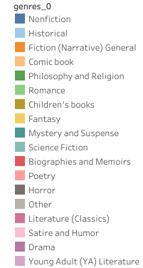

Exploratory Data Analysis

Slide 5
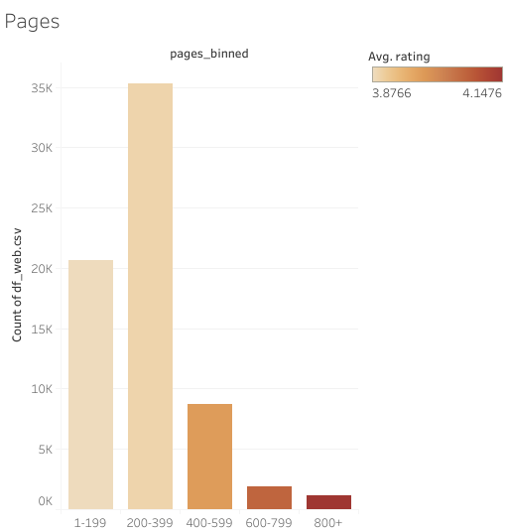
Number of books according to the pages they have

Slide 6
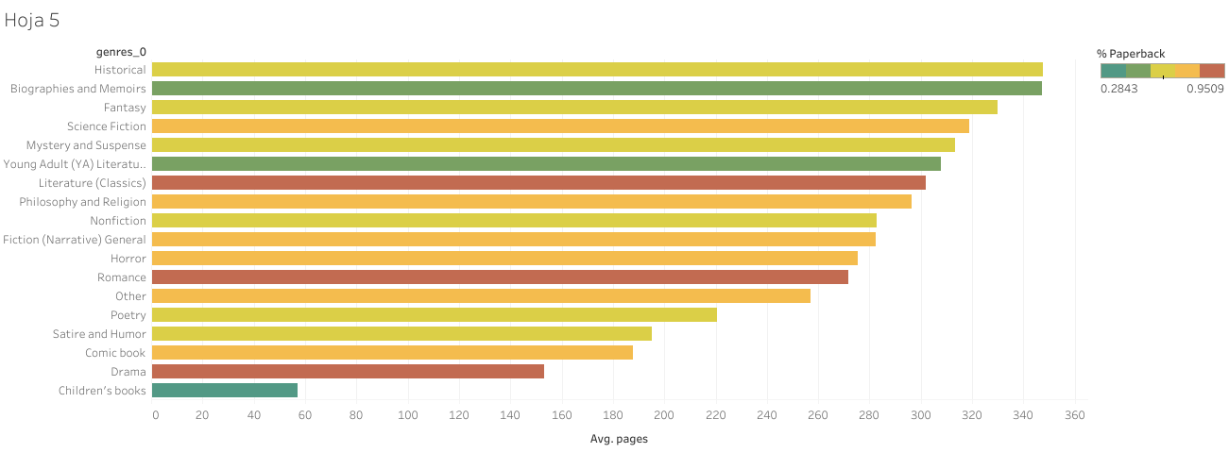
Average number of pages for each genre

Slide 7

Streamlit turns data scripts into shareable web apps in minutes.
All in pure Python. No front‑end experience required

Slide 8
Now let's check the website
https://summer-book-recommender.streamlit.app/

Slide 9
Pros and cons of Streamlit
STREAMLIT is a very useful tool if you want to make an interactive dashboard instead of using TABLEAU
Greater freedom and therefore greater possibilities of carrying out your ideas
Greater complexity and therefore probably more time you will invest
Possible problems linking GITHUD and STREAMLIT

Slide 10

Major Obstacles
Learn how to use Streamlit
Group 265 book genres into 18
The time allocated to achieve an attractive design
Problems deploying the website with GitHud

Slide 11

Conclusions
The most popular books are those that have less than 400 pages
Curiously, the books best valued by readers are those with the most pages
If we want a light book with a paperback format to go to the beach, it would be best to opt for a drama or romance book

Slide 12

Thank you for your time!
Jordi Díaz Carné

